Slide 1
Barcode-based data collection

Slide 2
Definition: Plot identifier (PLOT OBS_UNIT_ID)
Each time a new study is created, unique plot observation unit IDs are auto-generated and assigned by the BMS.
An observation unit is represented by the unique plot ID or “PLOT OBS_UNIT_ID”

Slide 3
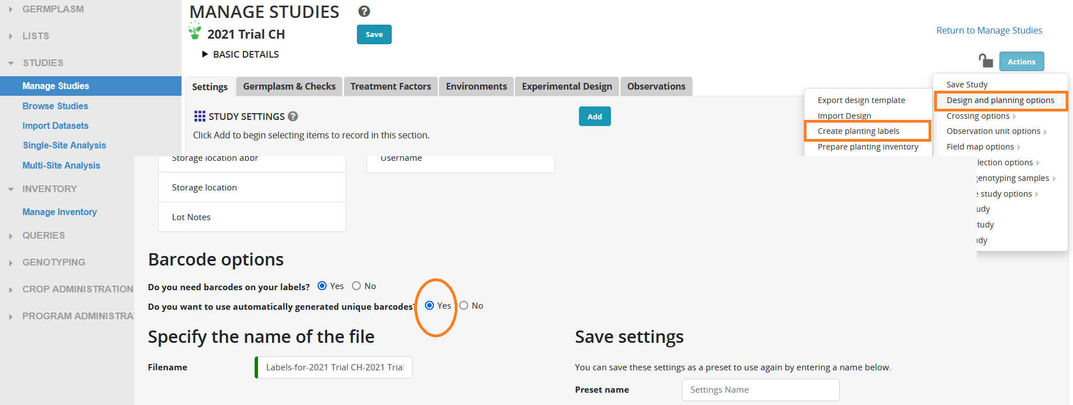
PLOT OBS_UNIT_ID as barcode on
plot tags in a field trial
We recommend that you use the automatically generated barcode, which is based on the unique plot ID.

Slide 4
Objective of barcode use
Scanning a barcode replaces manual typing of an important BMS unique identifier, and facilitates in:
Ensuring that the capture of trait observation data using the KSU Fieldbook app is linked to the correct observation unit (combination of variety, plot, replication (if any), environment and study) (scan PLOT OBS_UNIT_ID barcode)

Slide 5
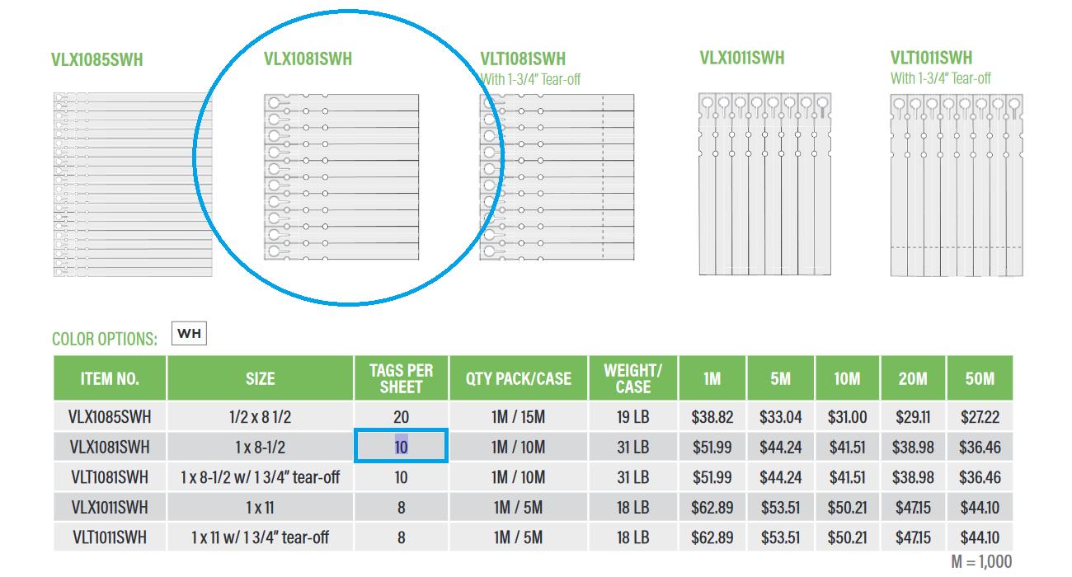
Example plot tags
VLX1081SWH (1" x 8 1/2" Valueline Laser Slip-On Tags)
Weather-resistant
Barcode labels can be printed using ordinary laserjet printer

Slide 6
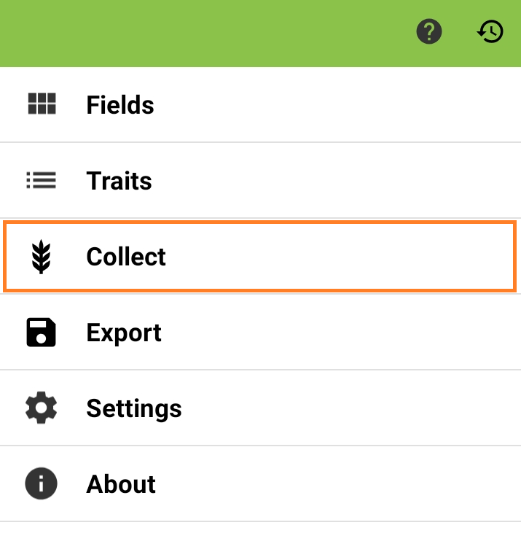
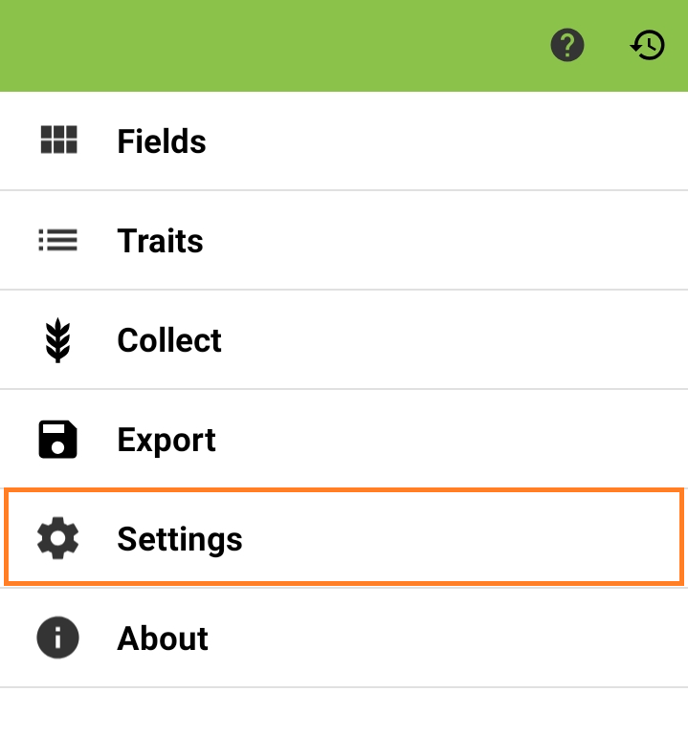
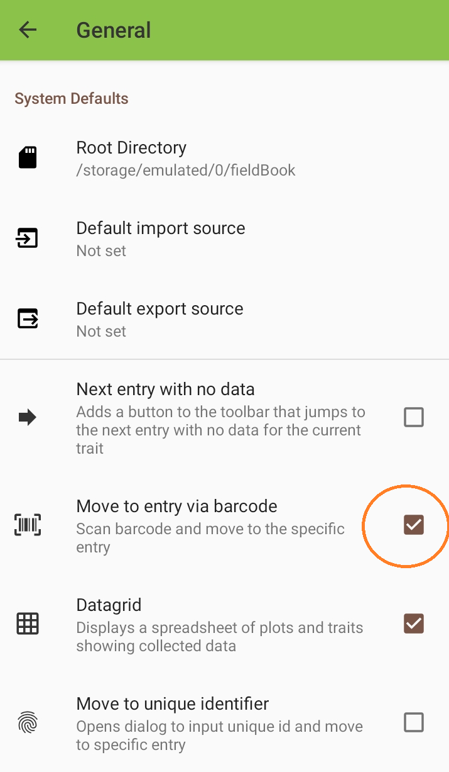
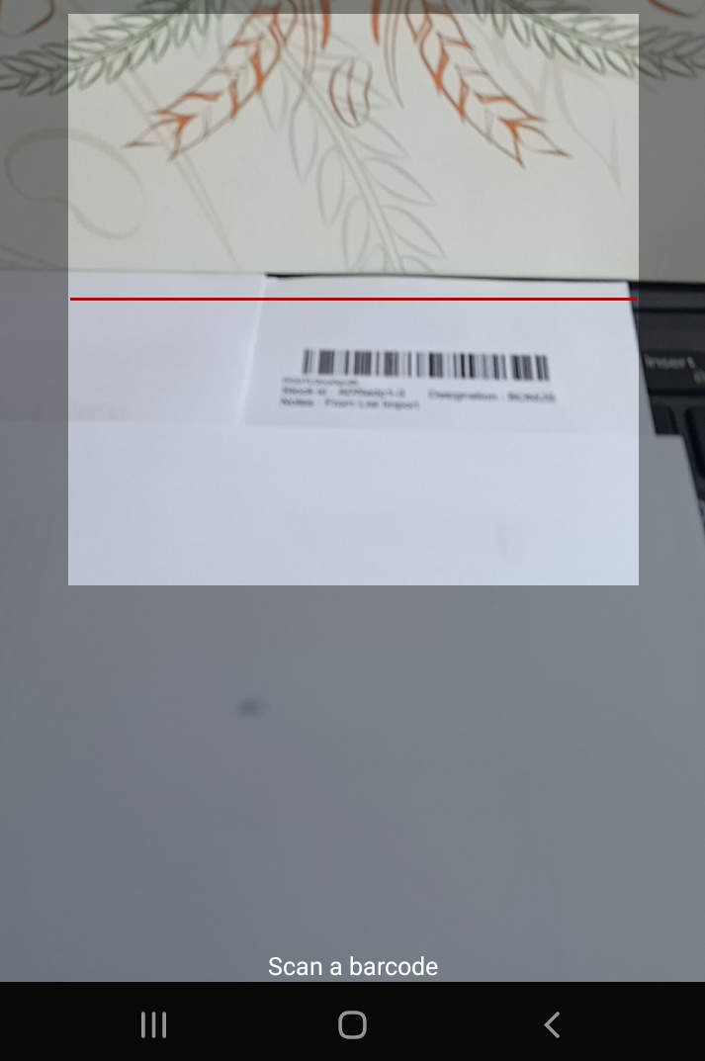
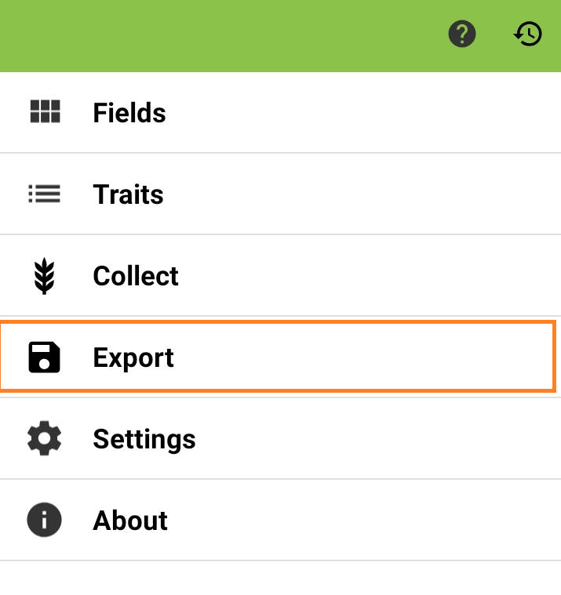
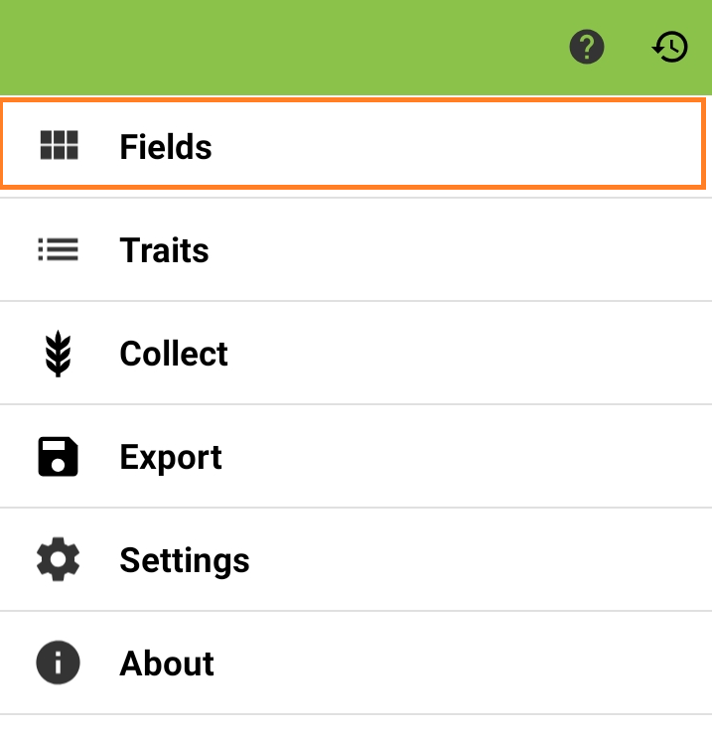
Workflow : Trait data capture using PLOT OBS_UNIT_ID barcode
Launch
Configure settings
Fields : BrAPI Import
Click barcode icon
BrAPI Export
Trait data
Fieldbook app
Open study on BMS
General : Enable “Move to entry via barcode” feature
Data capture
Retrieve BMS study environment
Input trait data
Confirm or discard pending data transmitted from Fieldbook
Read barcode PLOT OBS_UNIT_ID
Notes:
Recommended weather-proof plot tags:

